Slide 1


Project Report on
College Event Management System
Submitted For Partial Fulfil Towards the Degree Of BACHELOR OF COMPUTER APPLICATION [BCA]
YEAR: 2024-2025
Submitted To:
M.K. INSTITUE OF COMPUTER STUDIES, BHARUCH
Submitted By:
Panchal Vaidehi Sanjaybhai Exam Seat No: 1896
Internal Guide: Meghna Vithlani

Slide 2
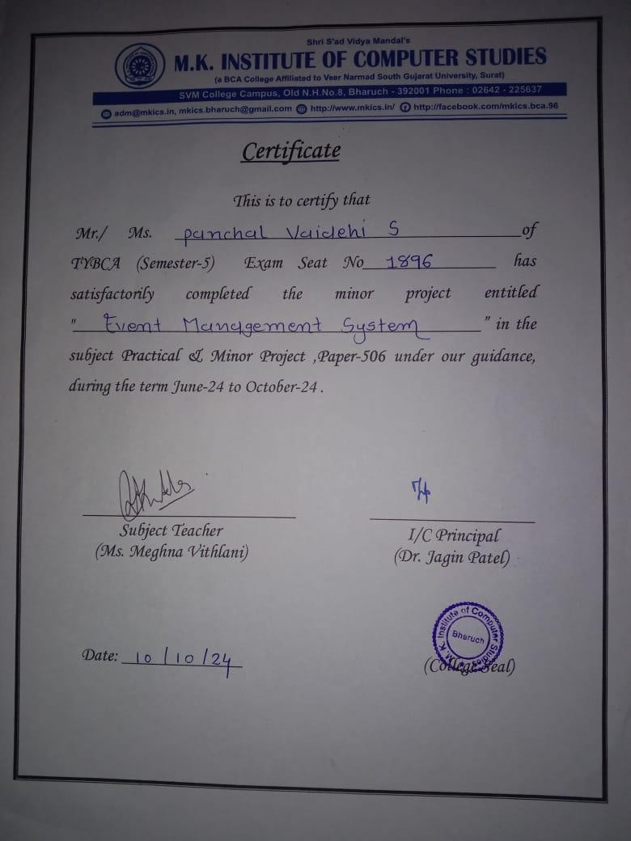
Certificate

Slide 3
Index
No. | Title | Page No
1 | Project Profile | 3
2 | Project Introduction | 4
3 | Scope And Objective | 5
4 | Tools And Technologies | 6
5 | Table Design | 7
6 | DFD | 10
7 | System Module | 17
8 | Screenshots | 18
9 | Future Enhancement | 29

Slide 4
1.0 Project Profile
Project Name : | Event Management System
Developed By : | Panchal Vaidehi Sanjaybhai 22B055
College Details : | Name : M. K. Institute of computer studies Address : Old NH-8,College Campus, Bharuch Phone : 02642 225637 Email-id : mkinstitute@gmail.com Website : www.mkics.in
Internal Guide : | Meghna Vithlani
Front End : | Html, Bootstrap 4, JQuery, CSS
Back End : | MySql
Server Side Scripting language: | PHP

Slide 5
2.0 Project Introduction
The College Event Management System is designed to streamline the organization and management of events within a college environment.
Managing various events such as seminars, cultural fests, workshops, and sports activities can be challenging and time-consuming without an efficient system.
This system aims to simplify event planning, registration, and communication between event organizers and participants.
By leveraging a web-based platform, it provides a seamless solution for students, faculty, and administration to manage college events efficiently.
2.1 Project Definition
The College Event Management System is a web-based platform designed to facilitate the
efficient planning, organization, and management of college events. It allows users to register for events, view event details, and communicate with event organizers, ensuring smooth
coordination between participants and administrators.

Slide 6
3.0 Scope And Objective
3.1 Scope
Scope for admin
Create event login
View user details
Update and delete any user details
View all event details
Update and delete any event details
View user wise, event wise and booking event report
View feedback
View user event bookings
Scope for Users
Login Username And Password
Give a feedback
Book event as per user requirements
View its own booking
View and update profile
3.2 Objective
The objective of the College Event Management System is to provide a user- friendly platform for efficient event management, enabling seamless coordination, registration, and communication between students, faculty, and event organizers within the college.
4.Tools And Technologies

Slide 7
4.1 System Technologies
Html
CSS
JavaScript
JQuery 3.1
Bootstrap 5
PHP 7.4.26
AngularJS
4.2 Tool For Used To Development
Visual studios
4.3 Software Requirements
Back End : MySql 5.7.36 , PhpMyAdmin 5.1.1, Apache 2.4.51,WampServer 3.2.6 - 64bit
Operating System : Windows 10 And windows 11
Browser Supports : Google Chrome, Microsoft Edge
5.Table Design

Slide 8
Table Name | admin_master
Description | This table provide the information about admin
Field Name | Data type | Constraints
admin_Id | Int | Primary Key
admin_name | Varchar (100) | Not Null
admin_Password | Varchar (100) | Not Null

Slide 9
Table Name | event_master
Description | This table provide the information about event
Field Name | Data type | Constraints
event_id | Int | Primary Key
event_name | Varchar (100) | Not Null
event_description | Varchar (100) | Not Null
event_date | Date/Time | Not Null
event_location | Varchar (100) | Not Null
event_time | Date/Time | Not Null
event_charges | Varchar (100) | Not Null

Slide 10
Table Name | feedback_website
Description | This table provide the information about feedback
Field Name | Data type | Constraints
f_id | Int | Primary Key
user_id | Int | Not Null
Message | Varchar (100) | Not Null
Email | Varchar (100) | Not Null
10

Slide 11
Table Name | participate_master
Description | This table provide the information about participate
Field Name | Data type (Size) | Constraints
participate_id | Int | Primary Key
event_id | Int | Not Null
User_id | Int | Not Null
participation_status | Varchar (100) | Not Null
p_name | Varchar (100) | Not Null
Status | Int | Not Null

Slide 12
Table Name | user_master
Description | This table provide the information about user
Field Name | Data type | Constraints
user_id | Int | Primary Key
user_name | Varchar (100) | Not Null
user_email | Varchar (100) | Not Null
user_password | Varchar (100) | Not Null
user_address | Varchar (100) | Not Null
user_age | Varchar (100) | Not Null

Slide 13
Table Name | audience
Description | This table provide the information about audience bookig
Field Name | Data type | Constraints
a_id | Int | Primary Key
event_id | Int | Not Null
Name | Varchar (100) | Not Null
Address | Varchar (100) | Not Null
phone number | Int | Not Null
Members | Varchar (100) | Not Null

Slide 14
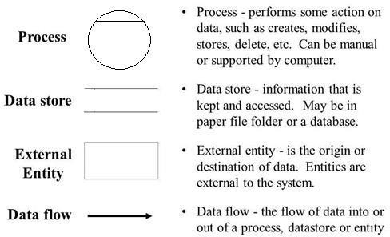
6. DFD(Data Flow Diagram)
Definition
Data flow is a network diagram illustrating a computerized system, manual or a combination of both, and representation in the form of a set of structured system components that are interconnected in accordance with the rules play. Advantages of DFD is possible to describe the system from the highest level and then them into a lower level (decomposition), whereas the lack of the DFD does not indicate the process is looping, decision-making process and the process of calculation.
Data Flow Diagram Symbols
Context Level DFD

Slide 15
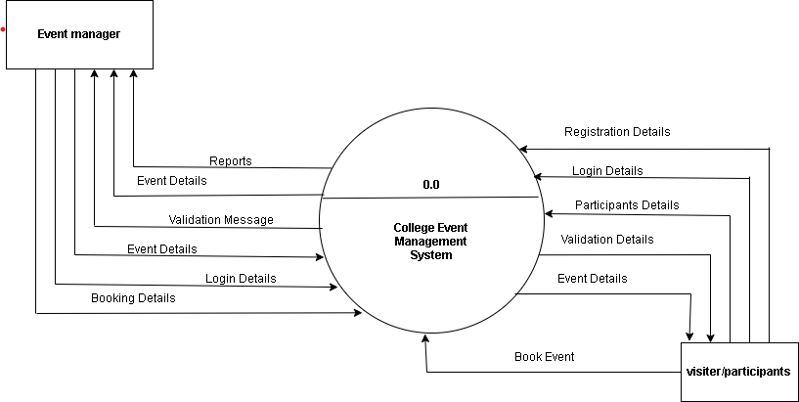
1ST LEVEL DFD FOR USER

Slide 16
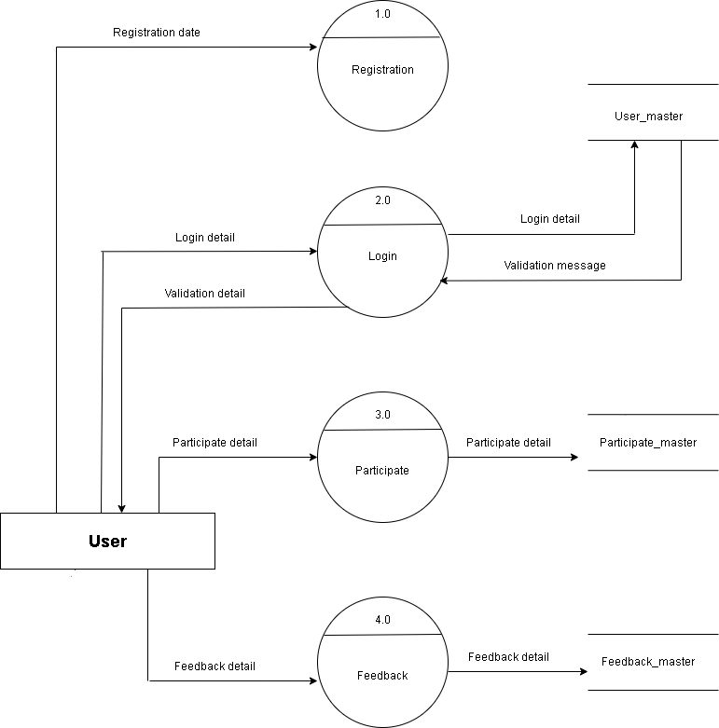
1ST LEVEL DFD FOR ADMIN

Slide 17
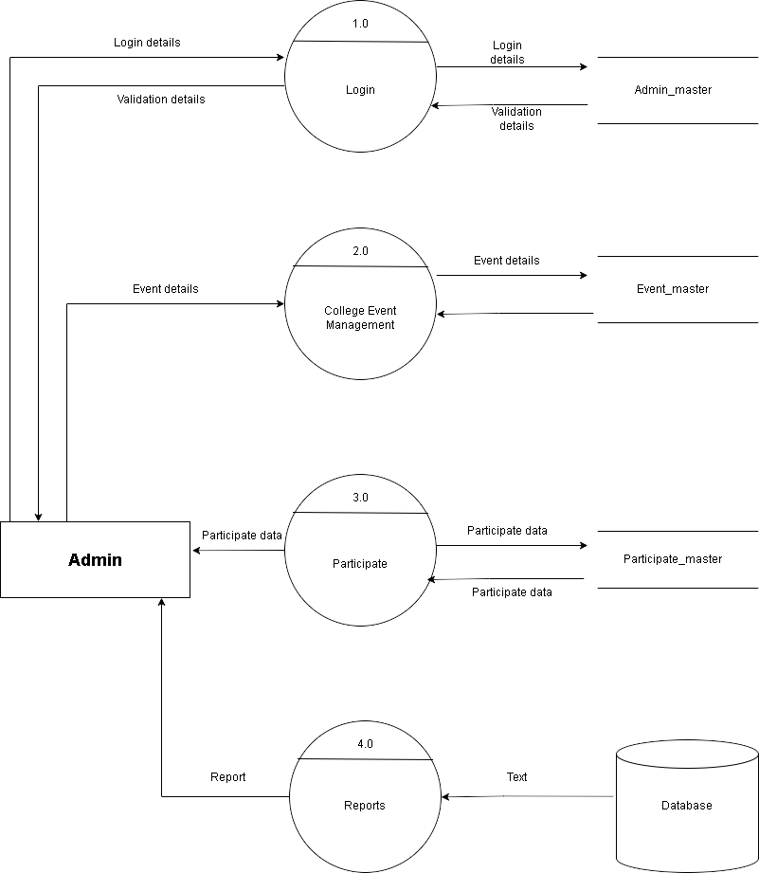

Slide 18
7. System Module
There are two modules:
Admin 2)User
Functionalities
Admin Module
login.
view users , remove them and update them.
add new event , update event and remove event.
view user wise bookings.
view feedback.
generate reports.
There 4 type of reports:
User wise report.
Event wise report.
All participate report.
Date wise booking report.
User Module
login.
search event .
book more than one events according its requirements.
view booked event and cancel event.
give a feedback.
view its own profile and update profile.
Admin Module
login here.

Slide 19
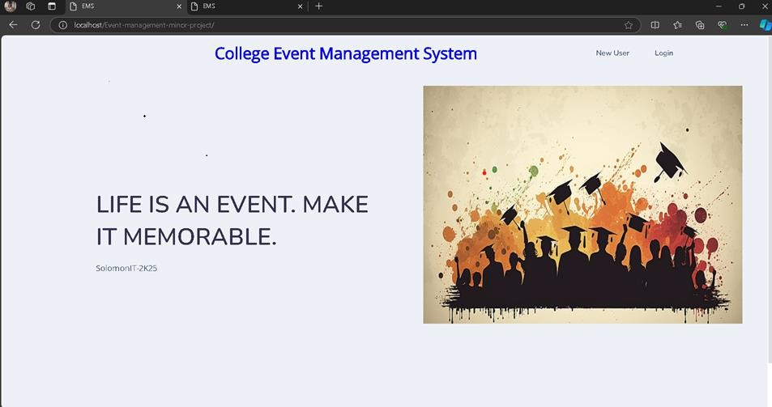
view participate list.
view and update profile,
8. Screenshots
User Side:
User Index– Only user can see this index page
New User
Registration – New user can first time visit this website, it’s compulsory to register this form.

Slide 20
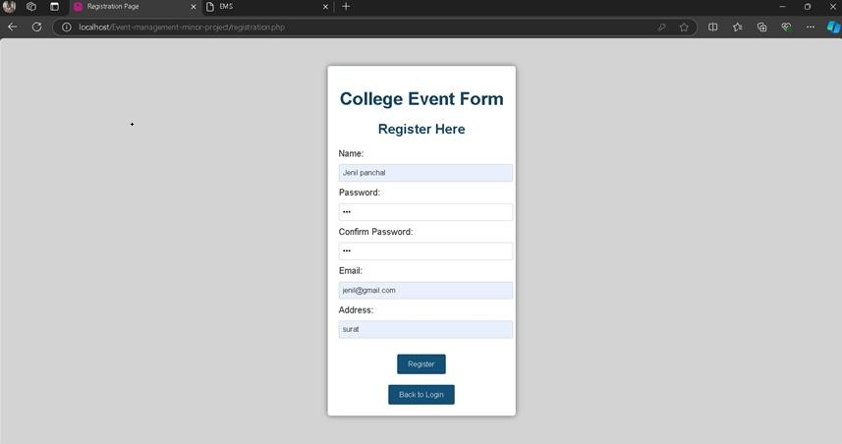
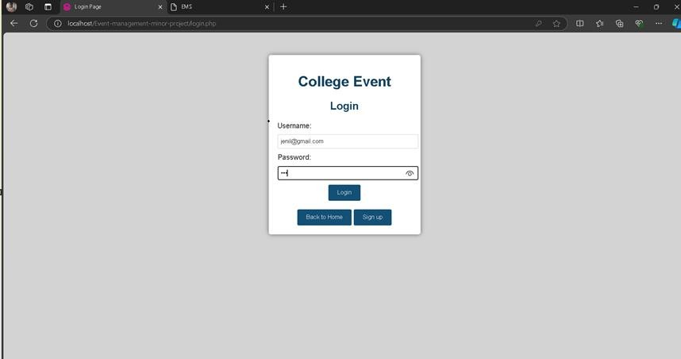
User Login – User can login their email and password which was registered on registration form.
20

Slide 21
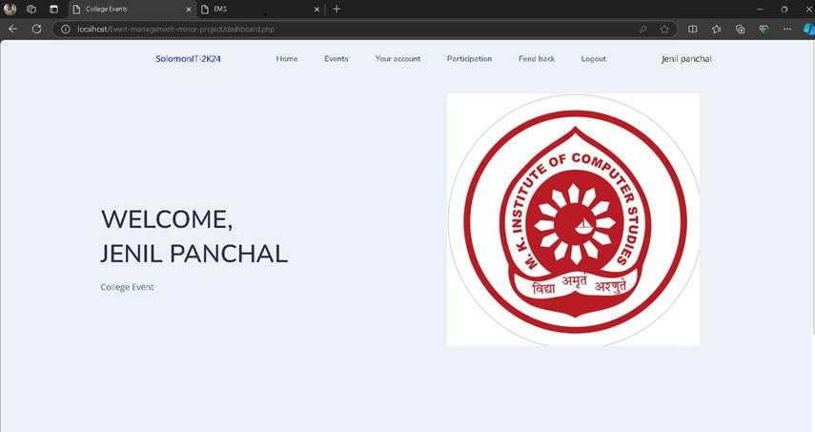
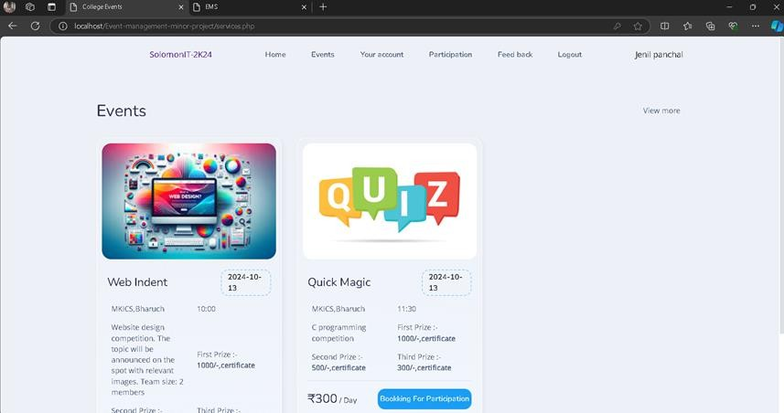
Dashboard – User can see this page after then they logged in to the system.
Events – Only user can see this event page here.

Slide 22
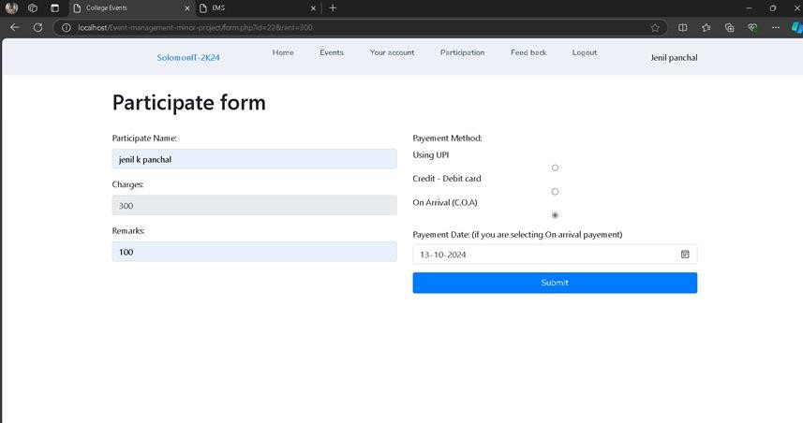
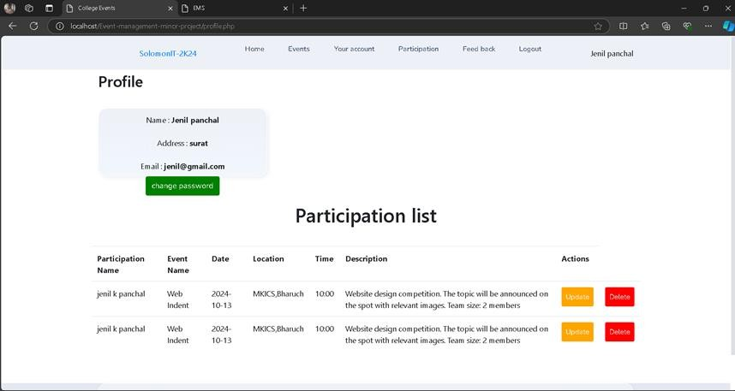
Booking For Participation – User can participate particular event, which they want to part.
Profile & Participation List – User can see their profile here, also check or manage their participate details.

Slide 23
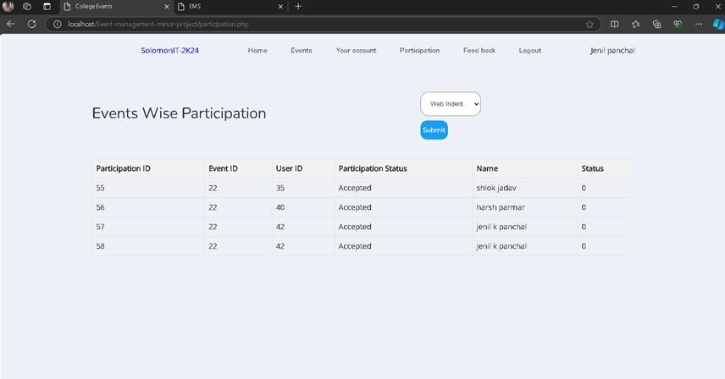
Event Wise Participation Reports – User can see their profile here, also check or manage their participate details.

Slide 24
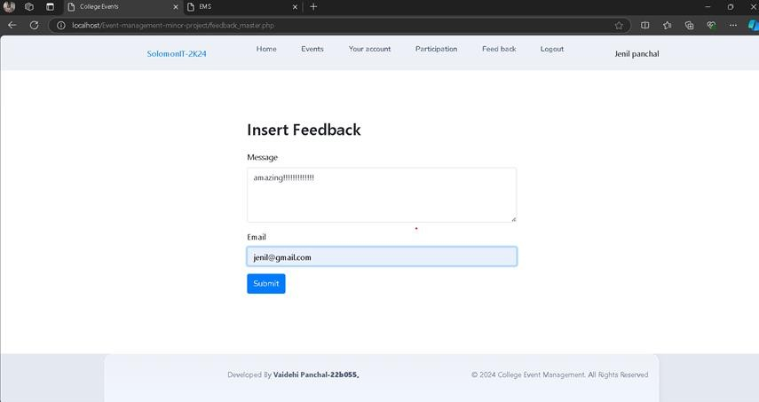

Insert Feedback– User can insert feedback here their own experience.
Logout– User can click on logout then user leave this system.

Slide 25
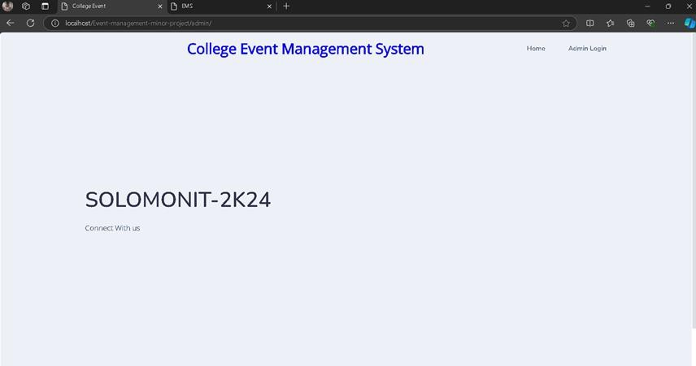
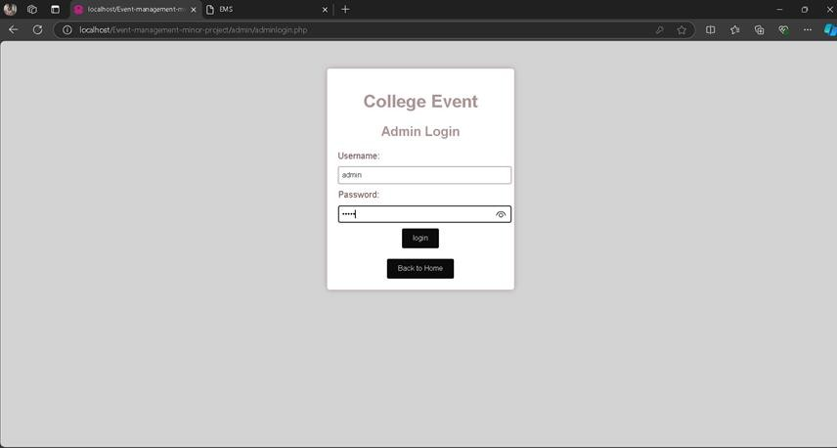
Admin Module:
Admin Index– Only admin can see this page.
Admin Login – Only admin can login here.

Slide 26
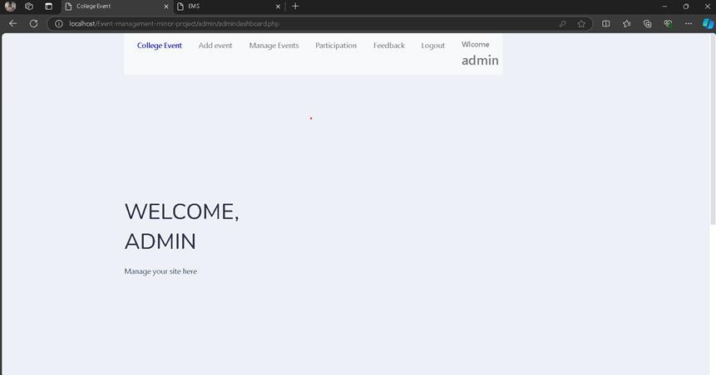
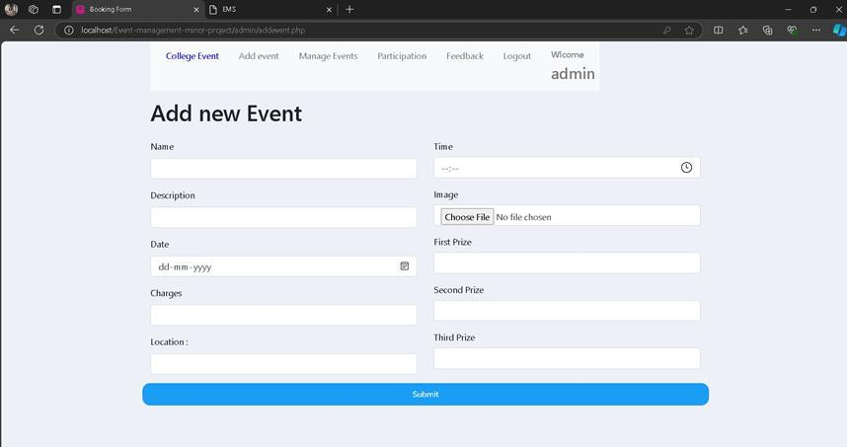
Admin Dashboard – Only admin can see this page after then they logged in to the system.
Add Event – Only admin can add new event here.

Slide 27
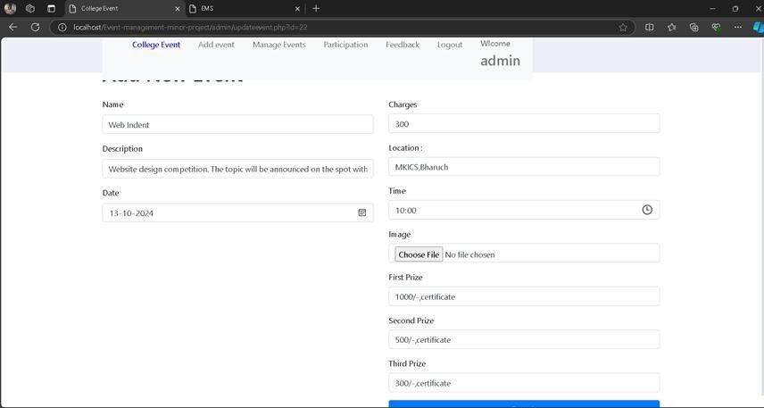
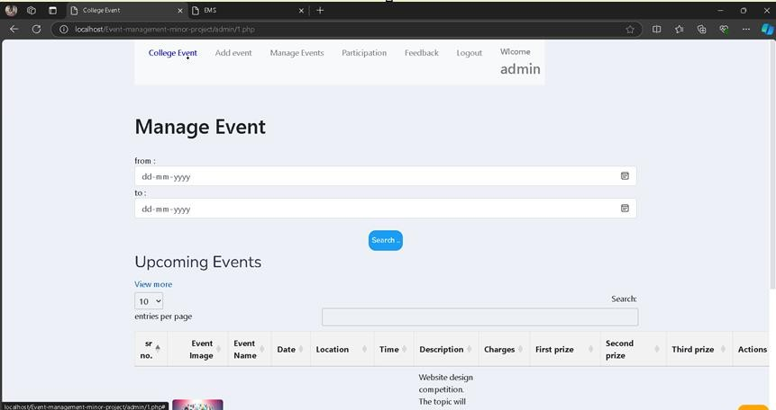
Update event – only admin can change and manage event.
Manage Events (Date Wise Event Report) – Only admin can manage events here.

Slide 28
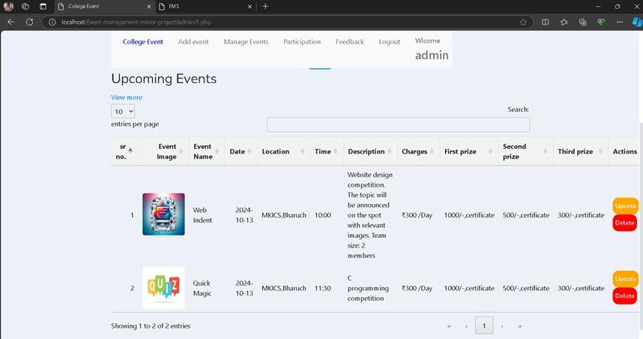
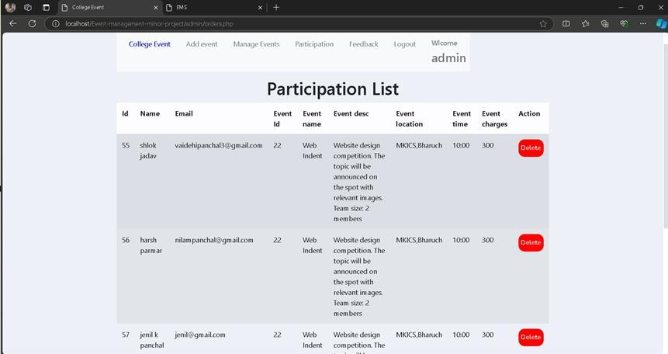
Participate list – only admin can see this page

Slide 29
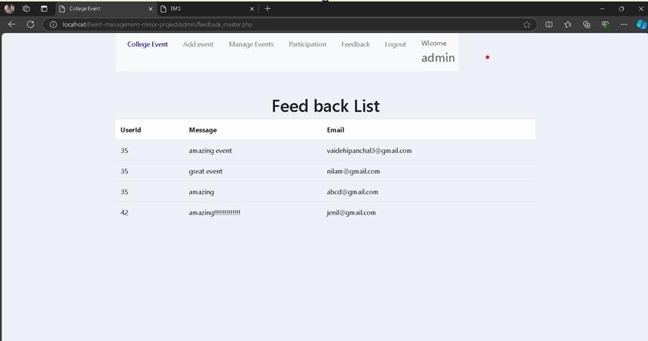
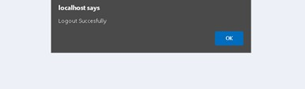
Feedback – only admin can see this page.
Logout -

Slide 30
9. Future Enhancement
In Future This Web Application will be serving as a complete service to user that include following feature.
Online Payment Will Be available.
User Will Be Able To Change Password Using OTP.
User will get a payment receipt.
More security will be provided.
30

